Slide 1
GROCERY WEB APP REQUIRED SKILLS: HTML,CSS
TEAM MEMBERS
PRASHANTH K (211521205109)
SANTHAKUMAR N (211521205135)
NITHISH S (211521205097)
SRI SAI BALAJI S (211521205157)

Slide 2
ABSTRACT
The Online Grocery Web Application revolutionizes traditional grocery shopping by providing a seamless, efficient, and user-friendly platform for customers to purchase groceries from the comfort of their homes. This application offers a wide range of products, from fresh produce to household essentials, ensuring that users can find everything they need in one place. It features a sleek and intuitive interface that enhances the shopping experience with easy navigation, detailed product descriptions, and high-quality images. The application also incorporates functionalities such as a customizable shopping cart, secure payment gateways, order tracking, and customer reviews. This digital solution not only saves time but also ensures a safe and convenient shopping experience, addressing the needs of modern consumers.

Slide 3
INTRODUCTION
In today's fast-paced world, convenience is key. The Online Grocery Web Application is designed to bring grocery shopping into the digital age, offering customers an efficient and hassle-free way to purchase their daily essentials. This innovative platform provides a comprehensive selection of grocery items, from fresh produce and dairy products to household necessities and personal care items. With a user-friendly interface, secure payment options, and reliable delivery services, this application ensures that customers can easily find, purchase, and receive their groceries without ever leaving the comfort of their homes. By integrating advanced technology and seamless navigation, the Online Grocery Web Application meets the growing demand for online shopping solutions, making everyday life simpler and more convenient.

Slide 4
EXISTING SYSTEM
The traditional online grocery web application depends only on the users requested items
and sometimes, it cannot suggests the items based on the customers requirements.
moreover it has limited grocery item which is available only in super markets.
Often, these platforms lack personalized recommendations, making the shopping experience feel generic.Lengthy and complicated checkout procedures can deter users from completing their purchases.Users are wary of how their personal and payment information is handled, impacting trust.Not all applications cater to users with disabilities, making it difficult for everyone to use the service efficiently.

Slide 5
EXISTING SYSTEM
Existing grocery web applications has the problems like:
Inventory Management Issues: Inaccurate stock levels can result in out-of-stock items or incorrect orders.
Complex User Interface: Overly complicated designs can make navigation and product searches cumbersome.
Delivery Delays: Unreliable delivery schedules frustrate customers and diminish trust.
Security Concerns: Ensuring data privacy and secure transactions is critical, but breaches can still occur.
Limited Payment Options: A lack of diverse payment methods can deter customers who prefer alternative payment systems.

Slide 6
PROPOSED SYSTEM
AI-Powered Recommendations: Suggest items based on user purchase history, dietary preferences, or current trends.
Voice Search: Allow users to search for products using voice commands, making it more accessible.
Recipe Integration: Link products to recipes, showing users what they can cook with the items they add to their cart.
Subscription Service: Offer subscription plans for regular deliveries of essentials like milk, bread, or pet food.
Augmented Reality (AR): Use AR to help users visualize how products look or fit in their homes, like the size of a fruit basket.

Slide 7
PROPOSED SYSTEM
Nutrition Info and Allergens: Detailed nutritional information and allergen warnings for all products, helping users make informed decisions.
Instant Checkout: Speed up the checkout process with one-click purchasing for registered users.
Eco-Friendly Options: Highlight eco-friendly or locally-sourced products to appeal to environmentally conscious consumers.
Mobile App Integration: Complement your web app with a mobile app for a seamless cross-device experience.
Delivery Slot Reservation: Allow users to reserve specific delivery slots based on their convenience.

Slide 8
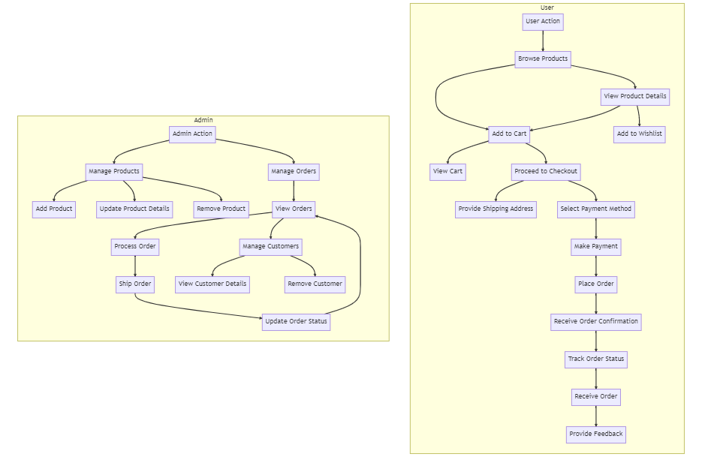
ENTITY RELATIONSHIP DIAGRAM

Slide 9
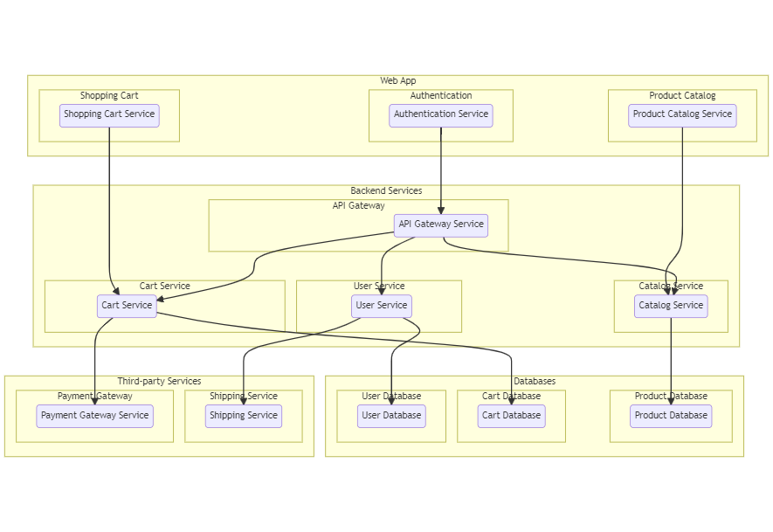
SYSTEM ARCHITECTURE

Slide 11
CONCLUSION
The development of the Online Grocery Web Application marks a significant step towards modernizing the grocery shopping experience. By leveraging advanced technologies and user-centric design principles, the application provides a seamless, efficient, and convenient platform for customers to shop for their daily essentials from the comfort of their homes. The integration of features such as AI-powered recommendations, secure payment gateways, and real-time order tracking ensures a personalized and reliable shopping experience. Additionally, addressing challenges such as inventory management and delivery logistics enhances the overall effectiveness of the system. As the demand for online shopping continues to grow, the Online Grocery Web Application stands poised to meet the evolving needs of consumers, offering a robust and scalable solution for the future of grocery shopping.

Slide 12
THANK YOU

